Slide 1

Workshop on IMT-2020 terrestrial radio interfaces evaluation
Wireless World Research Forum (WWRF)
10 December, 2019

Slide 2
WWRF Role and principles of operation
Develop future vision of the wireless world
Inform and educate on trends and developments
Enable and facilitate the translation of the vision into reality
Bring a wide range of parties together to identify and overcome significant roadblocks to the vision
Global
Open to all
Covers every platform
Not
standards body
research funding body
A typical research conference
Based on membership
All can attend meetings and make contributions

Slide 3
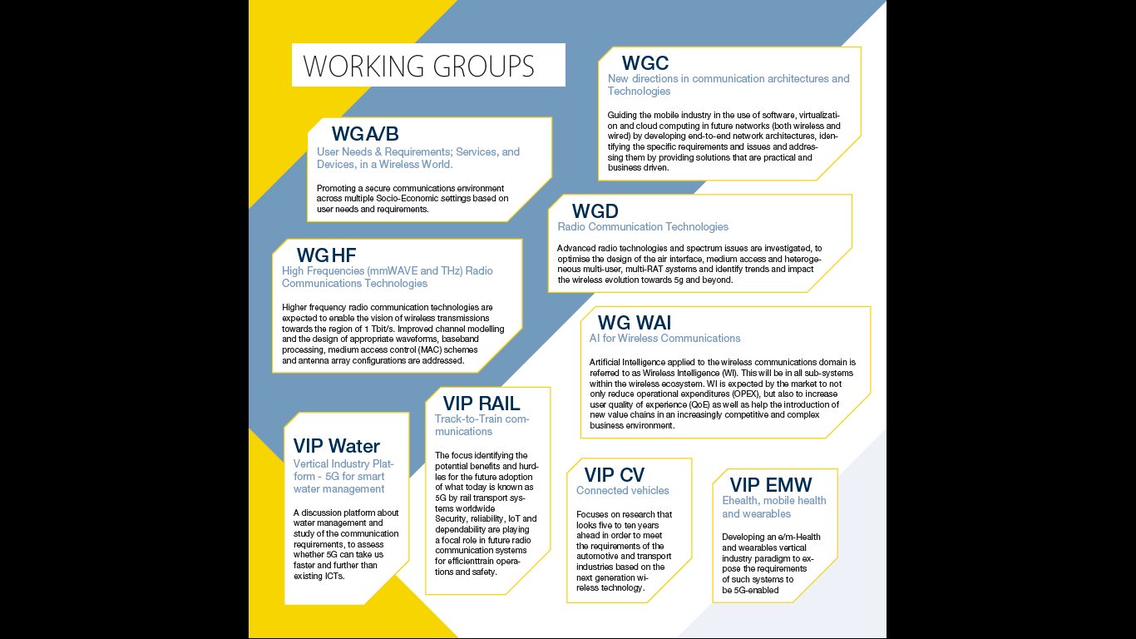

Slide 4
WWRF IEG
Members of the IEG include:
CSIR, South Africa
CTTC, Spain
Huawei, China
Intel, USA
Kings College London, UK
University of Piraeus, Greece

Slide 5
Intended Evaluation by WWRF
WWRF intends to evaluate the SRIT/RIT as the following table -
IMT-2020 SUBMISSION
3GPP |  | CHINA | KOREA | TSDSI | ETSI (TC DECT), DECT FORUM | Nufront
RIT | SRIT
IMT-2020/14 | IMT-2020/13 | IMT-2020/15 | IMT-2020/16 | IMT-2020/19 | IMT-2020/17 | IMT-2020/18
✔ | ✔* | ✔* | ✔* | ✔
The progress till now is initial evaluation of 3GPP RIT/SRIT and initial assessment of the characteristic template and compliance templates for TSDSI RIT
Comparing 3GPP NR RIT Submission, we find several modifications made in TSDSI RIT on top of 3GPP NR specifications, without any performance gains observed with in the scope of IMT-2020 Evaluation criteria in M.2412, i.e. Section 1)-19) of Submission. We don’t observe any performance contribution from major modifications, while only adding technical and implementation complexity

Slide 6
Preliminary Observations of TSDSI RIT
Addresses Standalone(SA) mode ONLY
None of the major modifications marked on top of 3GPP NR RIT appears applicable or contributes any performance gain within the specified scenarios and criteria for IMT-2020 Evaluation
The modifications on top of 3GPP NR RIT result in adding technical and implementation complexity, however
For 23dBm PC3 operation within the scope of M.2412, i.e. Sections 1) – 19) of TSDSI Submission, the performance of TSDSI RIT is similar with or less than 3GPP NR RIT
4. Supplementary information provided in Section 20) on 12KM LMLC (under Rural eMBB) which is beyond IMT-2020 Evaluation scope in M.2412. Results for Spectral Efficiency are provided at 3.5GHz carrier freq. with 60MHz CBW, without Link Budget and SLS details which is essential to permit technical evaluation by Independent Evaluation Group (IEG)-
Significant enhancement of Av. SE for 12KM ISD LMLC at 3.5GHz in Section 20) over 6KM ISD at 700MHz in Section 10.3.3) are counter-intuitive. We apprehend wrong fundamental assumptions or methodologies.
For large cell low mobility, M.2412 specifies 700MHz, the choice of 3.5GHz for 12KM ISD LMLC is not understood.
M.2412 Path Loss model is limited to 21KM. ITU approved model for 36KM+ distance needed for 12KM ISD.
The technology in Section 20) cannot be evaluated until the complete and specified information is provided, i.e. detailed link budget table, complete SLS simulation configuration, and various assumptions for the detection threshold of SINRs for data/control channels in UL/DL.
Therefore, WWRF observes that the submission of Section 20) is not self-contained, and is not providing complete and requisite details/information, as mandated by IMT-2020 Evaluation process to facilitate Independent Evaluation of claims.

